Slide 1
TensorFlow tutorial
Part1
Sungjoon Choi
(sungjoon.choi@cpslab.snu.ac.kr)

Slide 2
Overview
Part1: TensorFlow Tutorials
Handling images
Logistic regression
Multi-layer perceptron
Convolutional neural network
Part2: Advances in convolutional neural networks
CNN basics
Four CNN architectures (AlexNet, VGG, GoogLeNet, ResNet)
Application1: Semantic segmentation
Application2: Object detection

Slide 3
Before going on
Terminologies are Important!

Slide 4
Goal of (most of) Deep Learning
Most of the deep learning or machine learning algorithms can be viewed as a mapping from a vector space to another.
In other words, it is just numbers to numbers.

Slide 5
Input data

Slide 6
Output / Class / Label
Cat
[1 0 0 0]
Dog
[0 1 0 0]
Cow
[0 0 1 0]
Horse
[0 0 0 1]
One-hot coding

Slide 7
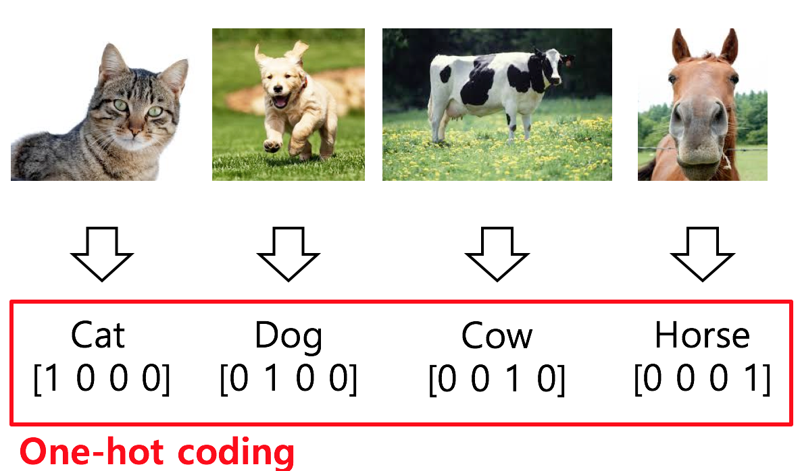
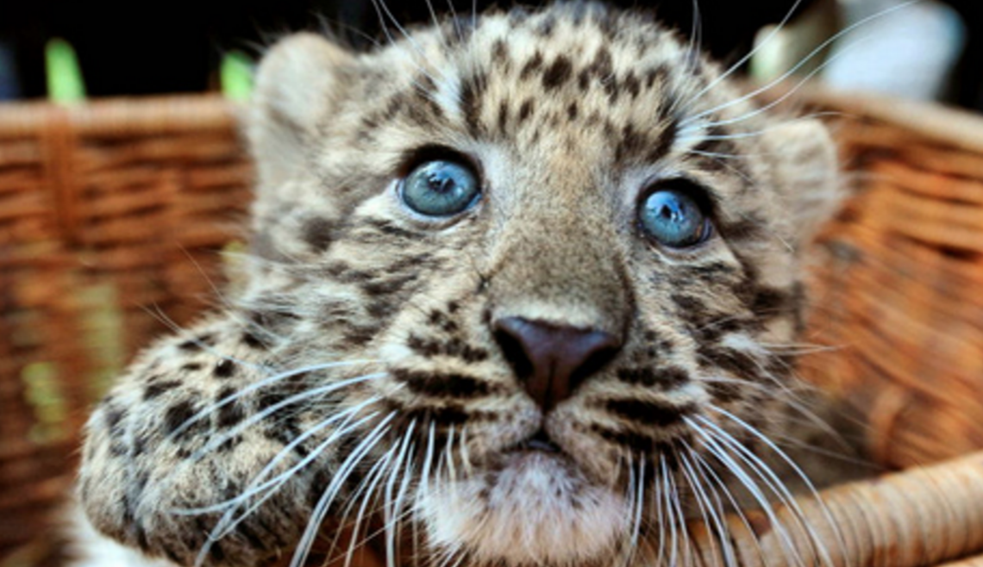
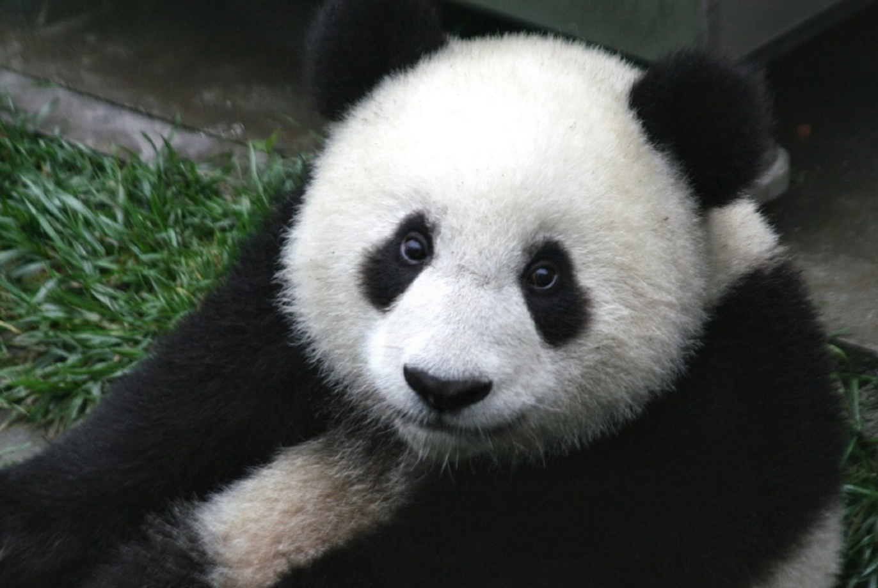
One-hot coding
Cat?
[0.9 0.1 0 0]
Cow?
[0.1 0.1 0.8 0]

Slide 8

Training / Learning

Slide 9
Epoch / Batch size / Iteration
One epoch: one forward and backward pass of all training data
Batch size: the number of training examples in one forward and backward pass
One iteration: number of passes
If we have 55,000 training data, and the batch size is 1,000. Then, we need 55 iterations to complete 1 epoch.

Slide 10
Part1: TensorFlow tutorial
Handling images
Logistic regression
Multi-layer perceptron
Convolutional neural network

Slide 11
Part1: TensorFlow tutorial
Handling images
Logistic regression
Multi-layer perceptron
Convolutional neural network

Slide 12
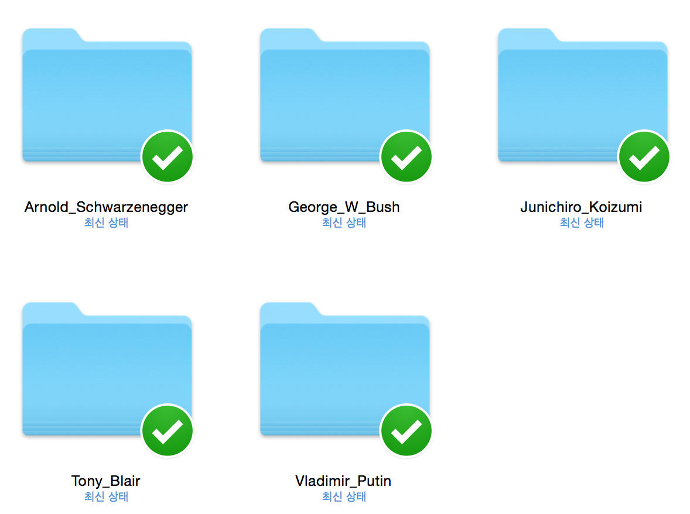
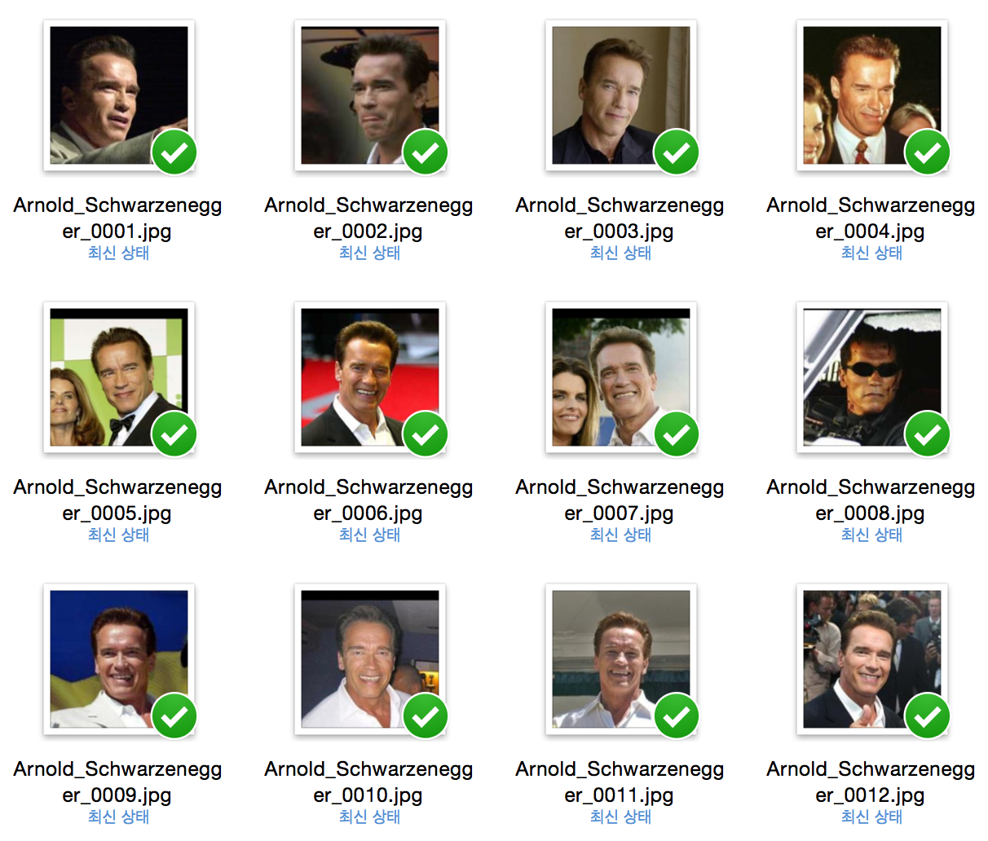
Custom dataset

Slide 14
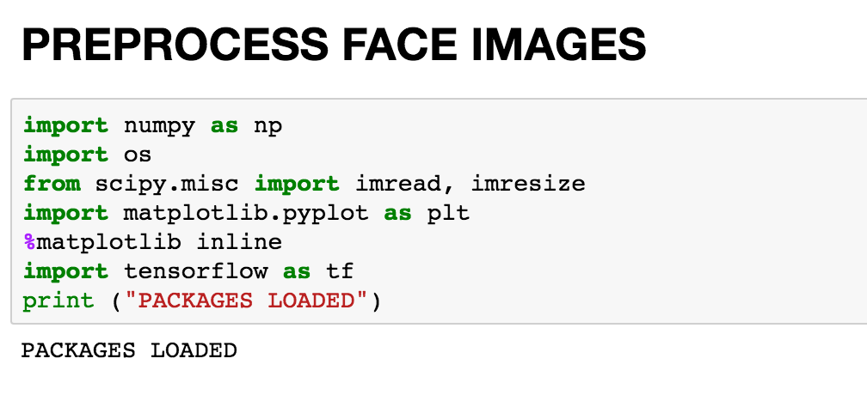
Load packages

Slide 15
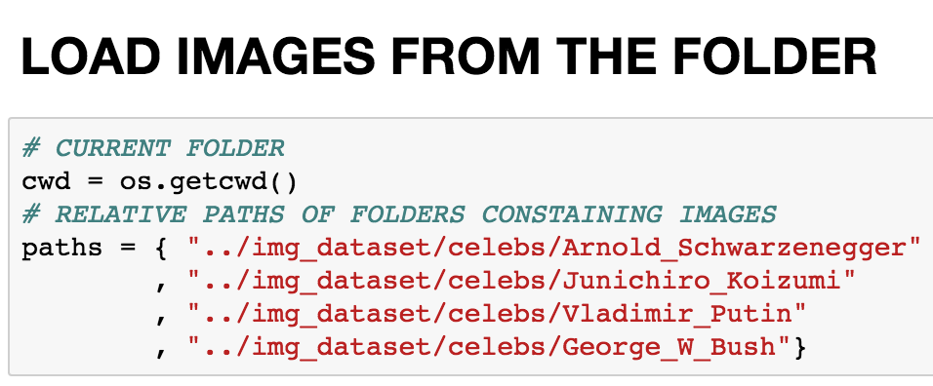
Specify folders containing images

Slide 16
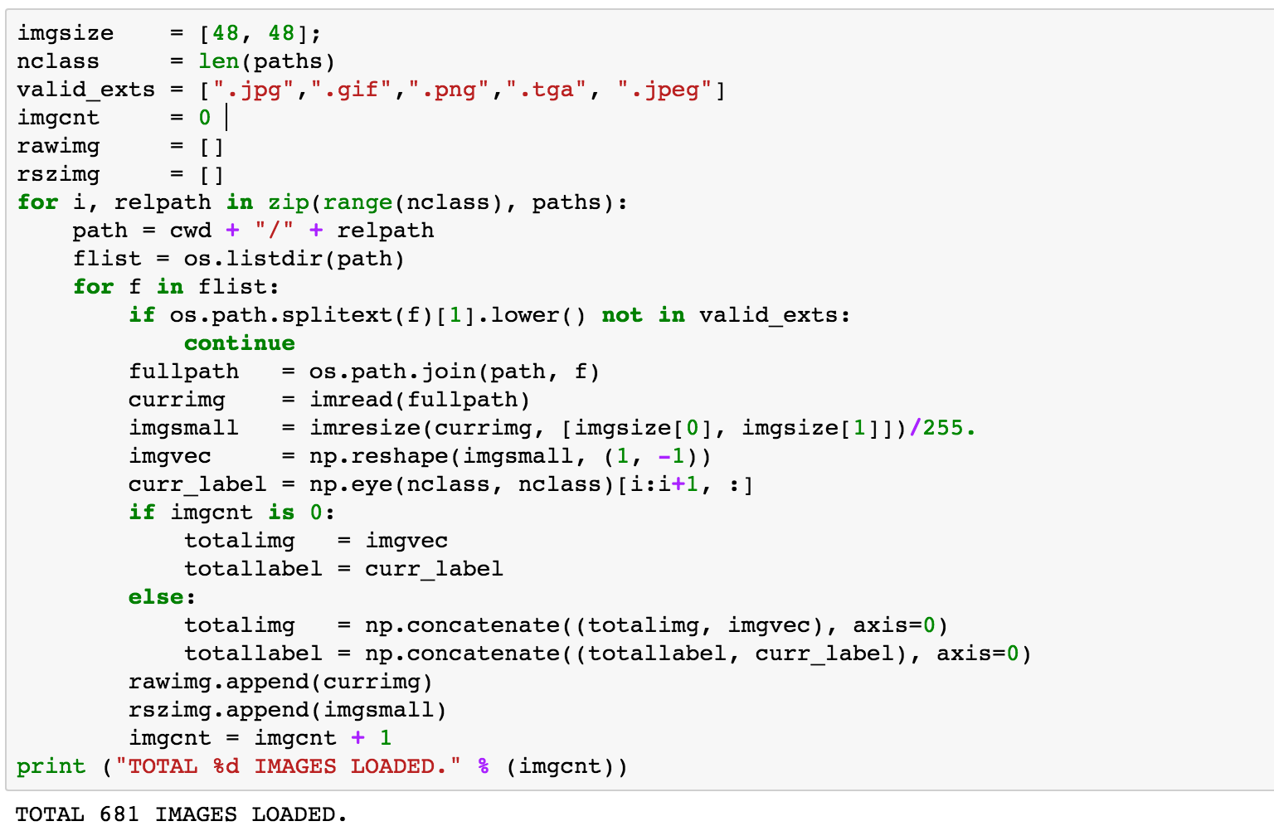
Load images

Slide 17
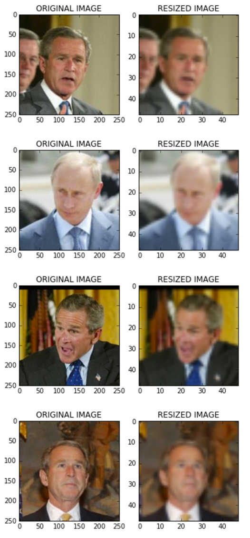
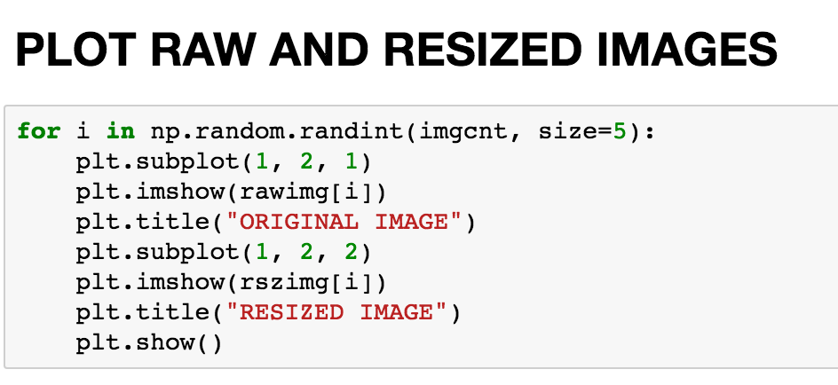
Check loaded images

Slide 18
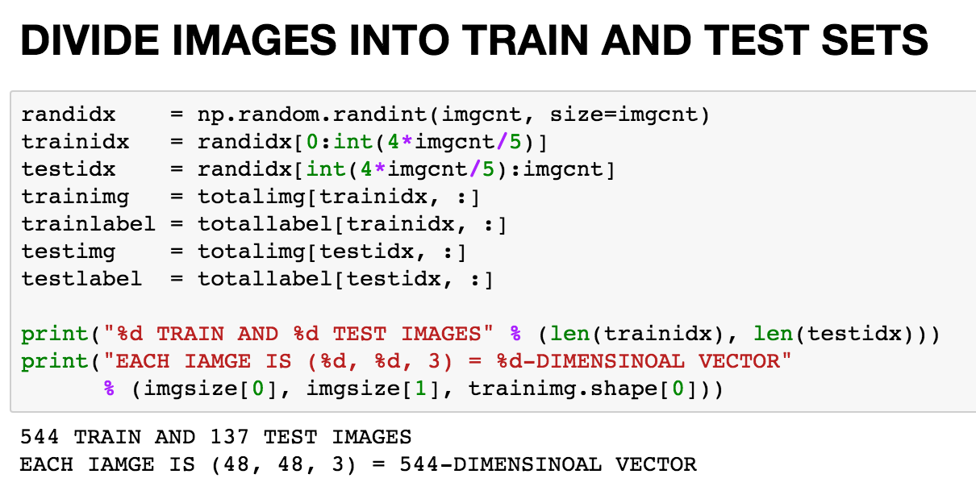
Divide into train and test sets

Slide 19
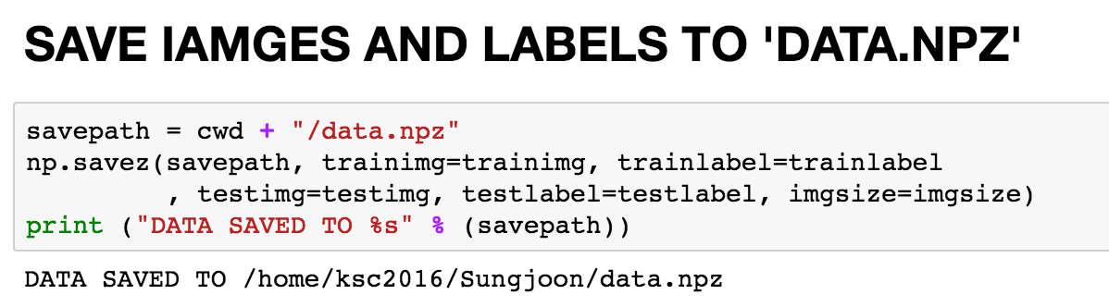
Save!

Slide 20
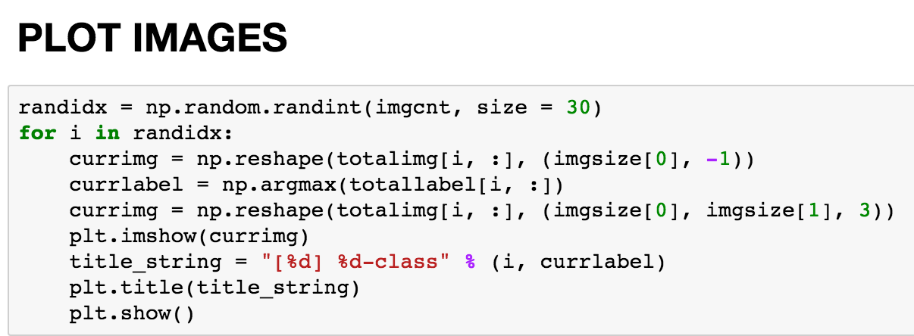
Plot to check

Slide 21
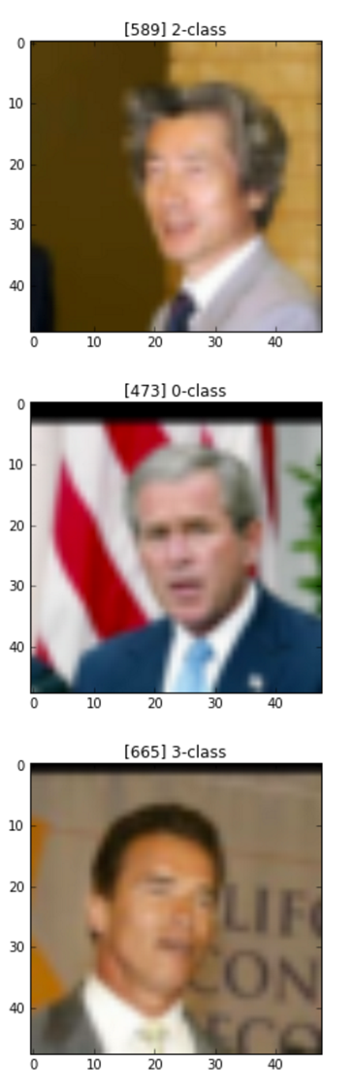
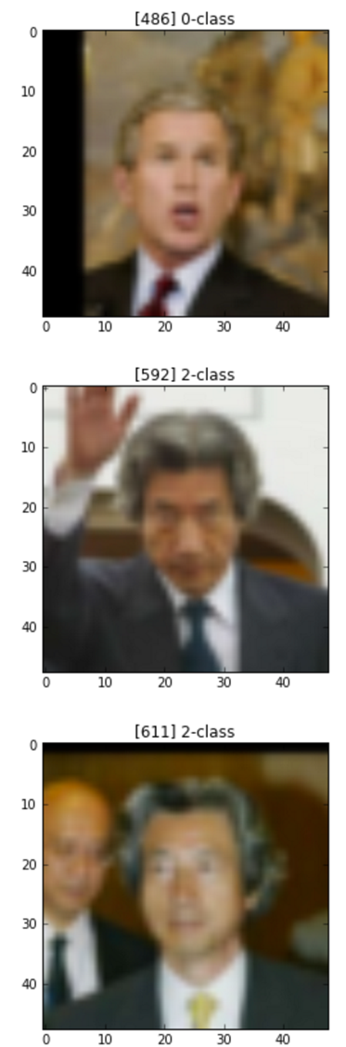
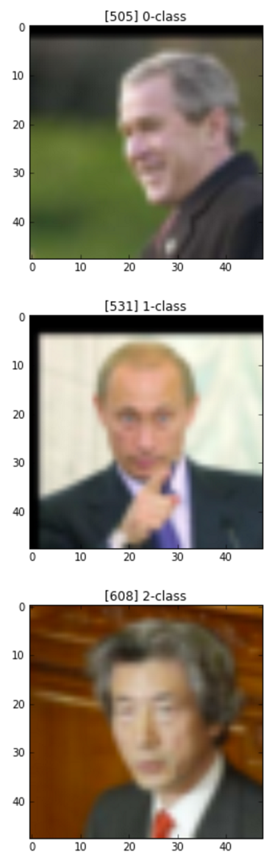
Plot to check

